Slide 1
Ecometachip-Mini
A Low-Cost, Eco-Friendly Chemical Identifier Utilizing a Novel Coir-Rubber Dielectric Sensor

Slide 2
Abstract
This paper presents the Eco-MetaChip Mini, a novel, low-cost, and eco-friendly system for the preliminary identification of common liquids based on changes in their relative permittivity (ϵr) using a novel rubber coir material.
Authors : Abhiram B, Aaromal A, Devanarayanan CR, Ivana Anto
Affiliation : School of Engineering, CUSAT (Kerala, India)

Slide 3

The problem
Benchtop FT-IR Spectrometers (current)
Need for low-cost, biodegradable sensing for field analysis

Slide 4
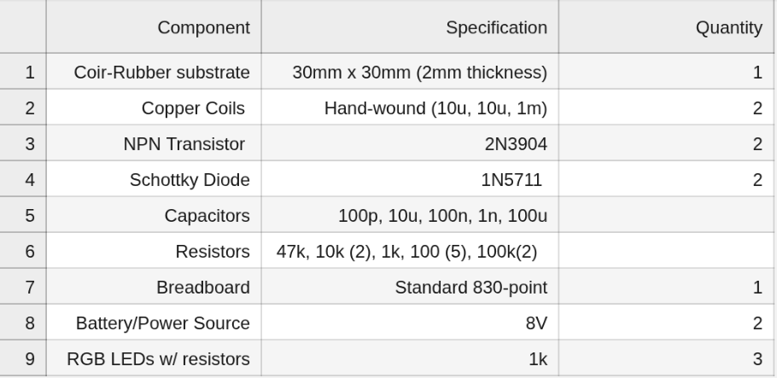
Materials Required

Slide 5
System Architecture
DC source
Hartley oscillator
mag. field
coir patch
(modulation)
coupling
Pickup coil
LEDS (Classification)
amplifier
DC
precision rectifier
100 MHz Hartley Oscillator coupled with dielectric resonator

Slide 6
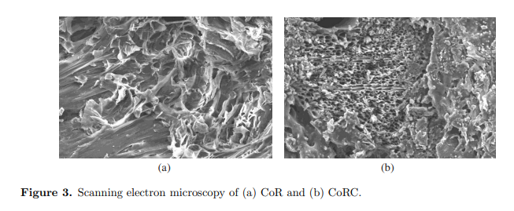

The Novel Material (Sensing Element)
Coir-Rubber Composite: Porous matrix allows liquid integration

Slide 7

Methodology/Physics (Dielectric Loading)
Liquid permittivity alters capacitance, modulating magnetic field amplitude

Slide 8
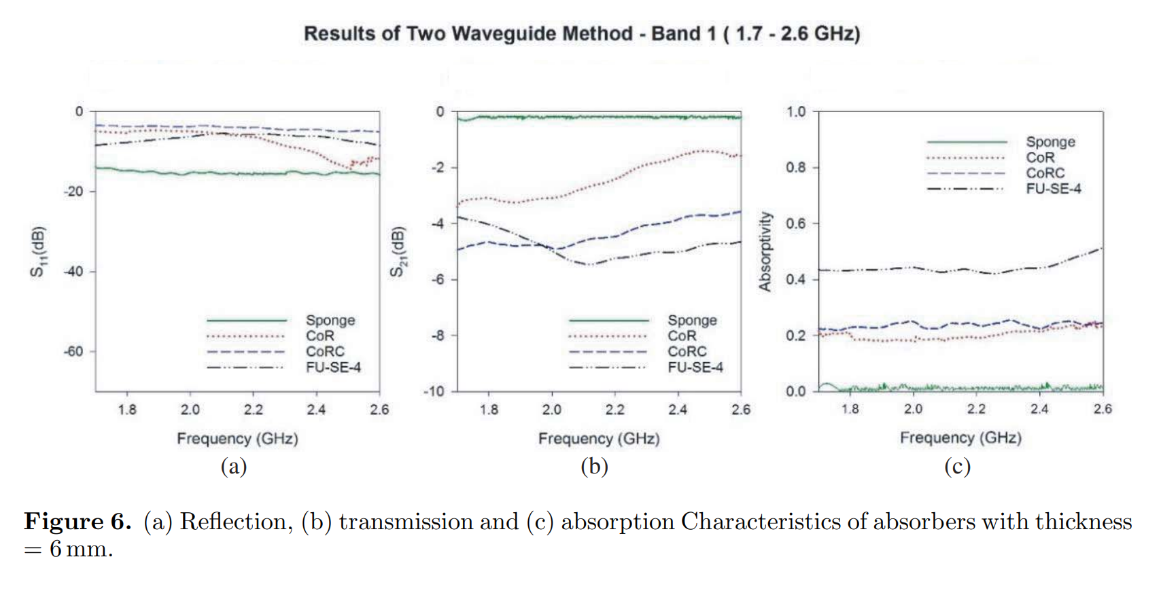
Addressing Signal Loss
Carbon content optimized for coupling, not just absorption (εr of rubber-coir substrate with liquid ∝ coupling factor)

Slide 9
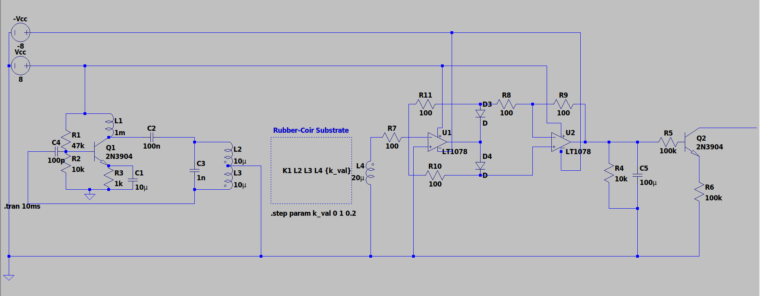
Circuit Implementation

Slide 10
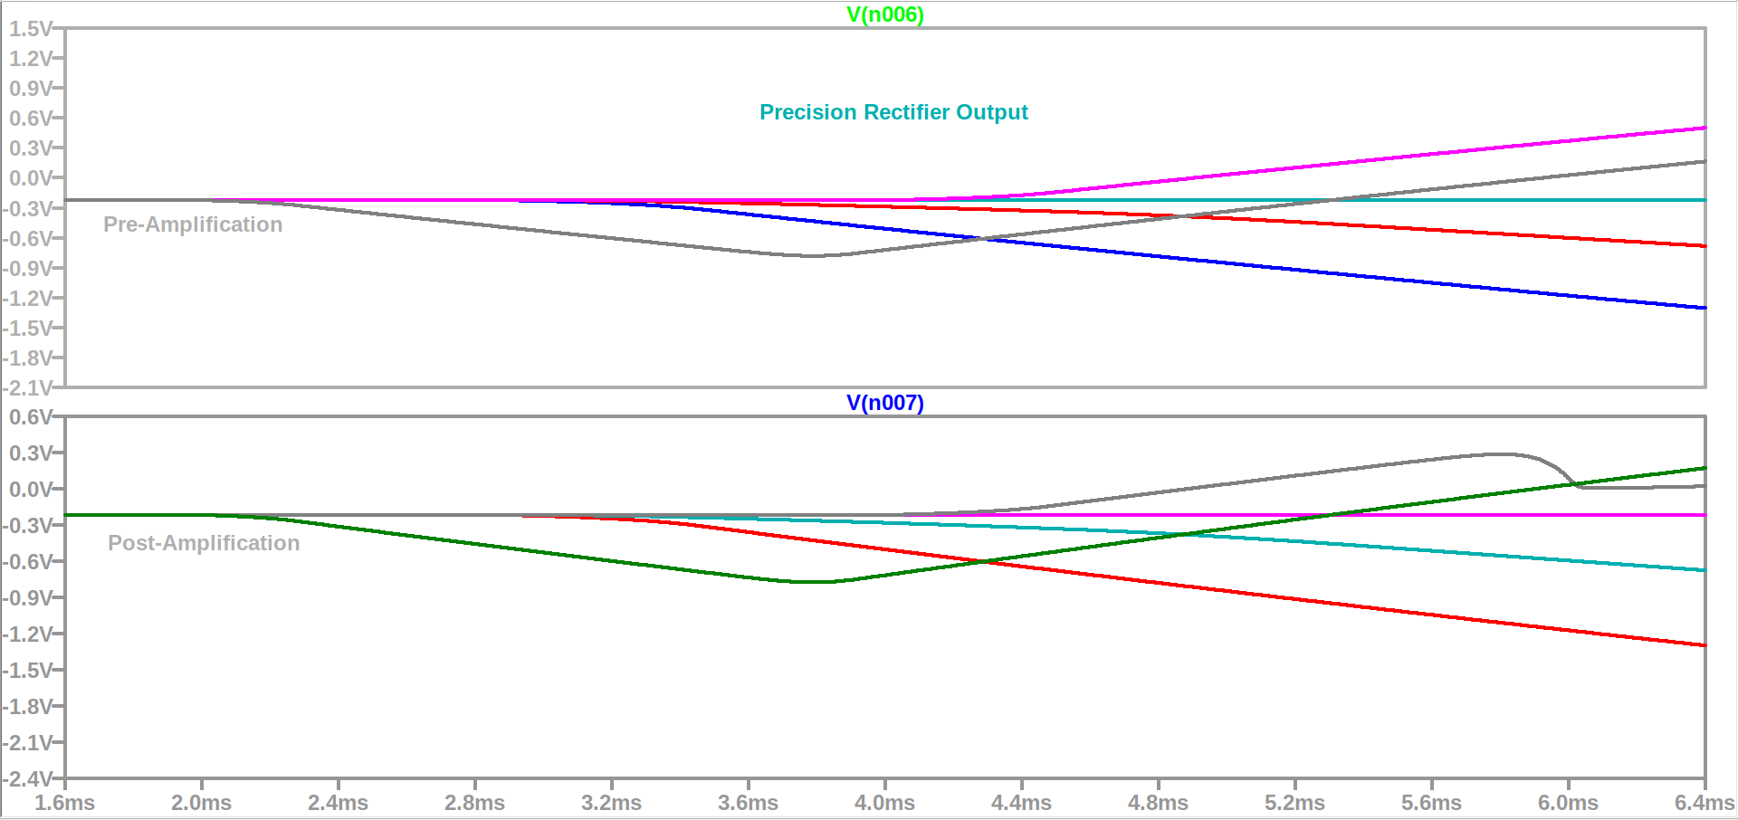
Simulation Results (Coupling)
For increasing k_values btw coils 0, 0.2, 0.4, 0.6 (εr of rubber-coir substrate with liquid ∝ coupling factor k)

Slide 11
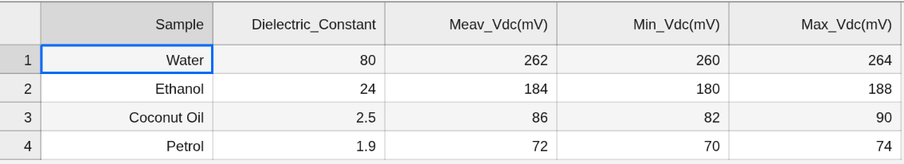
Experimental Observations
Higher permittivity liquids generate significantly higher output voltages.

Slide 12
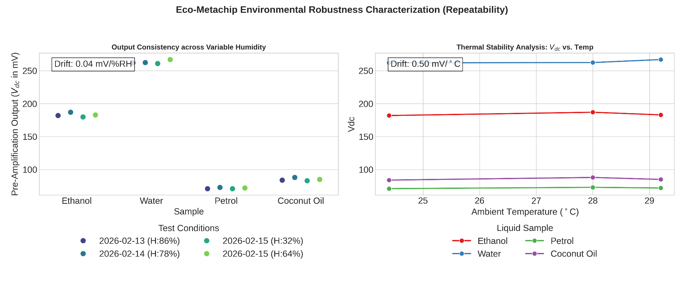
Repeatability

Slide 13
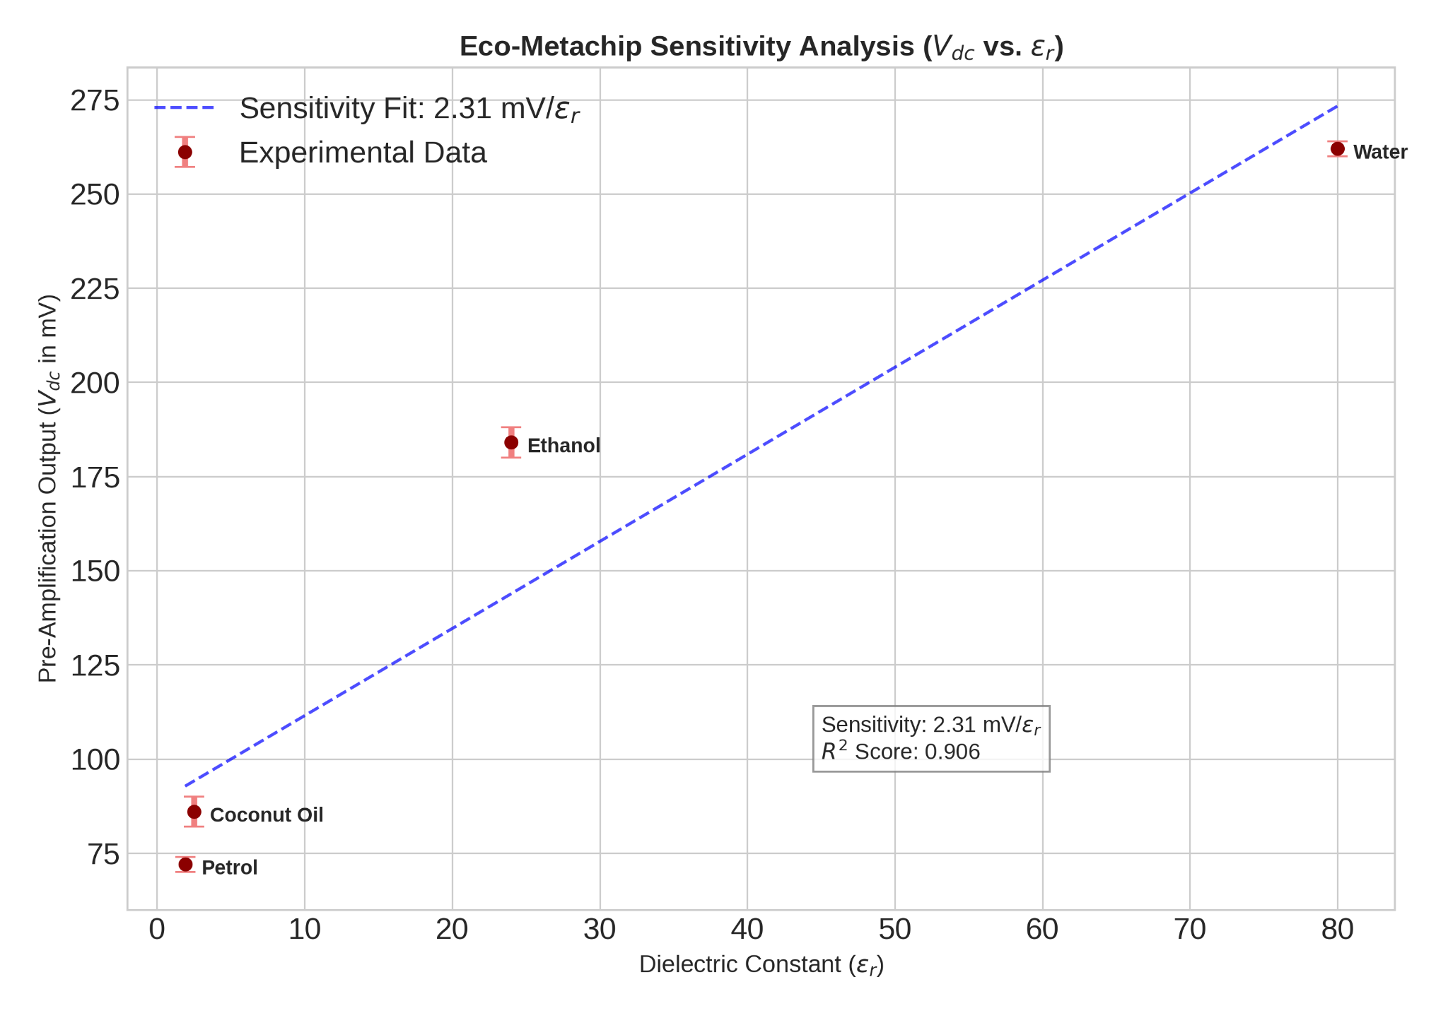
Sensitivity

Slide 14

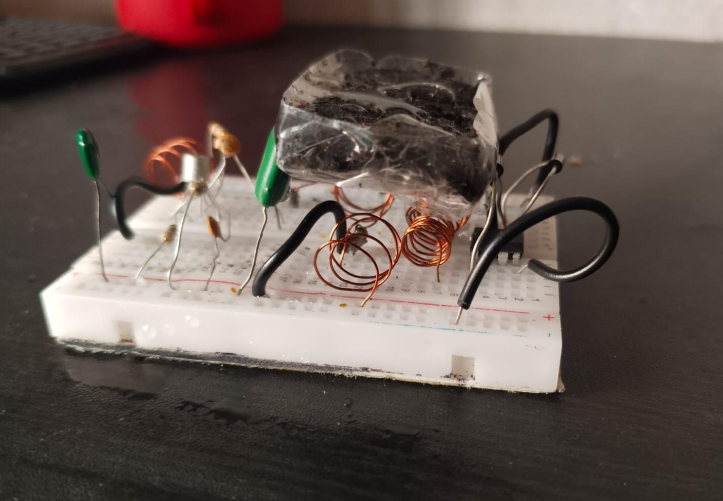

Exp-Setup & Visual Classification

Slide 15
Future : MCU intg. & Digital classification
Rectifier out
Amplifier (3.3V)
DC offset (Clamper)
MCU (w/ ADC)
Op-amp and MCU bridge digitizes analog output for quantitative chemical classification of liquid permittivity.

Slide 16
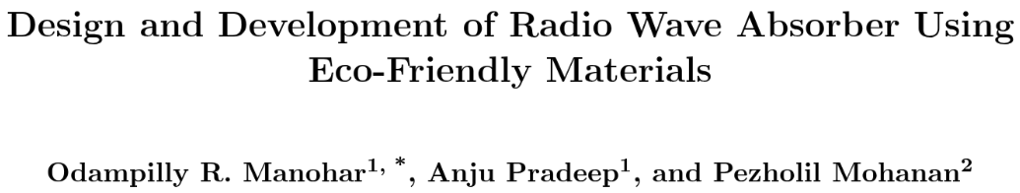

Conclusion & References
Eco-friendly, low-power solution for real-time liquid analysis
Reference research thesis :

